Slide 1
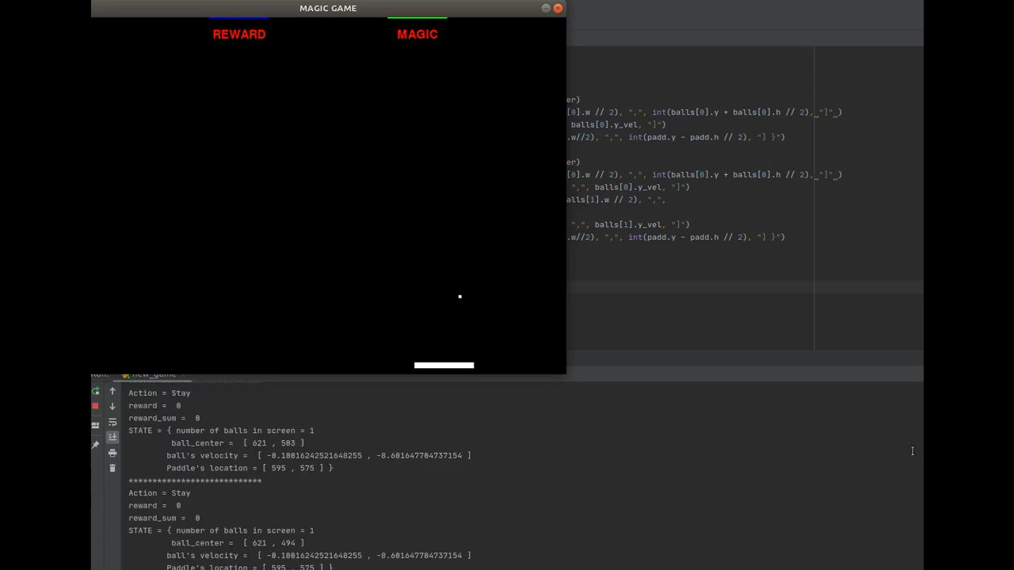
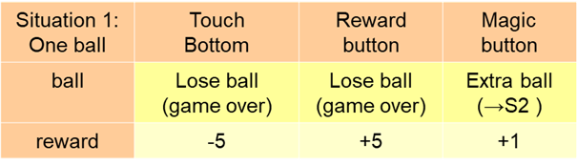
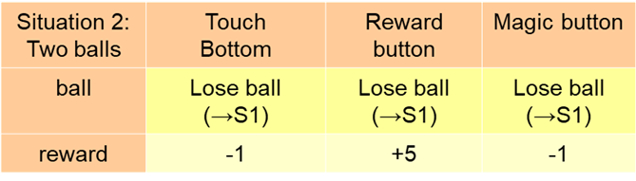
MAGIC GAME
Two Major Situations in the Game:
States: [Number of the balls, ball’s location, ball’s velocity and paddle’s location]
Actions: Right, Left , Stay
Amin Majdi

